Slide 1
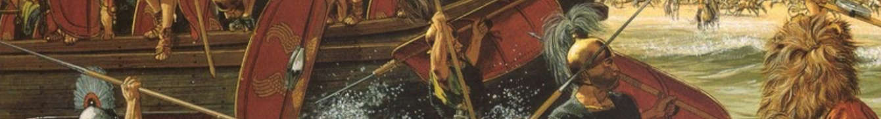
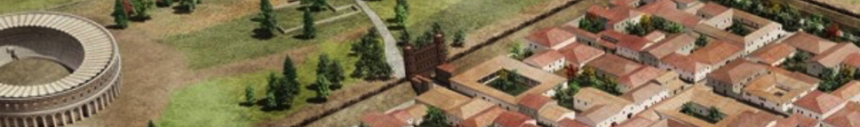

Knowledge organiser
Roman Britain
Wider World

Slide 2
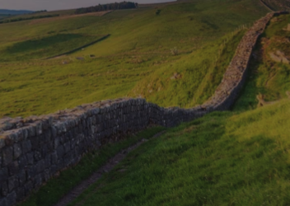
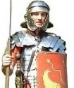
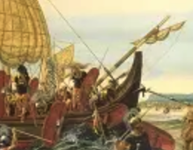

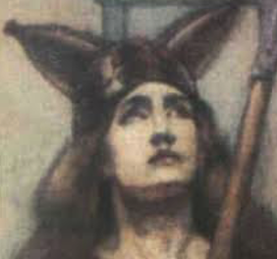
Roman Britain
Why this period is important
The arrival of the Romans to Britain and their occupation for over 350 years marks a turning point in the history of Britain. Not only did they transform the landscape they also left written records for the first time in the form of letters and coins and even graffiti. What people remember the Romans for most is the strength of their rule and their advanced lifestyle compared to the Iron age Britons. They introduced organised cities, roads, villas and even public baths connected through impressive system of well engineered roads. The Romans were able to keep control of Britain through use of their disciplined and well organised army which shortly after 410 AD left the Britons to rule themselves. Their legacy is still felt to this day, in the form of the Latin language, buildings, laws etc
Romans
Saxons
Iron age
55 BC
43 AD
61AD
122 AD
410 AD
Romans
Claudius invades and stays. Romans begin 367 years of continuous occupation
Queen Boudica of the Iceni leads rebellion against Romans but is defeated
Julius Caesars's army lands and briefly defeats some tribes and then leaves
Romans start to build Hadrian's Wall, marking the northern edge of their empire
Roman army leaves Britain

Slide 3

Roman Britain
Key vocabulary
Websites
English Heritage >>
BBC Teach – Class clips 1 >>
BBC Teach – Class clips 2 >>
British Museum
Roman Baths
St Albans Museum
Schools Learning Zone
KQ6
How much of our lives today can be influenced by the Romans?
Conquer/conquest | To take over land belonging to another country
Empire/Emperor | A sovereign ruler of an empire.
Frontier | Area near boundary with another country
Gaul Govern/ governor/government | Name for area we call France The way the country is ruled
Hypocaust | Central heating system
Invade/invasion | When an army or country takes over another country
Legion | Very large group of soldiers
Province raid | Part of a country brought under control of a government
Rebellion Rule/ruler | When people resist how they are being treated by using force against the ruler
Slave | Person who was owned by and worked for another
Tax/taxes temple | Money people had to pay to the government each year Place of worship
Tribe/tribal | Group of people, often from same family, who live in same place and have the same interests
Trade villa | Buying and selling goods Large country house for the rich, lots of which have survived
Worship/worshipped | To show a strong feeling of respect for a god(s)
KQ1
Why dd the Romans invade Britain?
KQ5
Why did the great 400-year Empire suddenly end?
KQ2
Why did Boudica (Celt) stand up to the Romans?
Top takeaways
Having studied this topic you should be able to:
Explain why Claudius invaded Britain when Caesar didn’t stay
Describe how Boudica stood up to the Romans
Explain why we have different interpretations of Boudica today
Describe 4 of the most significant changes the Romans made to how people lived, and how we know for sure
Explain why the Romans were so powerful but then left Britain after nearly 400 years
Describe the main ways in which the Romans still impact on our lives today, 2000 years later
KQ4
How much did Celtic life change after the Romans settled?
KQ3
How were the Romans able to keep control over such a vast empire?
Books to read
What the Romans did for us: Age 7-8, Alison Hawes
Everything: Romans in Britain: March onwards for facts, photos and fun! (National Geographic Kids)
Ancient Rome (DK Eyewitness)
Roman Life in Britain: Band 12/Copper (Collins Big Cat)
See Inside Ancient Rome (Usborne Flap Book)

