Slide 1







New starters
Reception
Autumn 2021
Getting Ready for
Reception
in the Foundation Stage.

Slide 2

Timings of the day
8:30am – School opens
8:45am – Bell rings/Register - time for Mums and Dads to say goodbye
9.50am – Fruit and milk time
10.00am-Phonics
10:30-10:45am – Playtime
12:15-1:00pm – Lunchtime
2:35pm – Afternoon playtime
3:05pm – Home time (please collect your child from the outer classroom door)

Slide 3
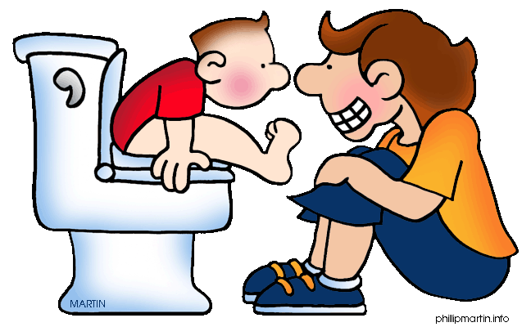
Toileting
It would be really helpful if your child can use the toilet completely independently before September. Accidents can happen and we will ensure your child is well looked after. A spare set of underwear
in a bag on your child’s peg is always handy too, though we
do have spares at
school if needed.

Slide 4

Dressing and undressing
To help your child manage getting changed for PE, encouraging their independence when dressing and undressing can give them a real head start. Tights, buttons and
laces can be a challenge
for many years yet but
general dressing and
undressing without
assistance
is a really important skill.

Slide 5



Fruit and milk
The children will have a fruit break at around 9.50am each morning.
We will provide each child with a piece
of fruit. Alternatively, the children can bring in a small fruit snack from home such as an apple, pot of strawberries, etc. Pop this in a labelled pot and place in the fruit tray in the morning. There you will also find a tray for
your child’s water bottle. Please
encourage your child to put these
in the trays themselves as part
of their morning routine.

Slide 6


Packed lunches and school dinners
The children’s lunch boxes aren’t refrigerated during the day, therefore it is important that they do not contain anything that relies on
this. You might find it handy to pack mini-ice
pouches to keep food cool. Fiddly pots or
clasps are best avoided too so your child can succeed at lunchtime.
The children will self-register each morning when they come into Lantic placing their name card in a pot to show me if they want a packed lunch or school dinner. If they are having a school dinner they will be able to choose from two options,
one of which will be a vegetarian choice.

Slide 7
Book bags and reading
We will begin teaching phonics soon after a period of settling in. Your child will have a book bag and will begin to bring books home for you to share together.
More information about our approach to teaching phonics and how you can help at home will be available at an online information evening in September.

Slide 8
Attendance
It is really important for your child to be in school very regularly. Our expectation for attendance is at least 97%.
We cannot authorise holiday requests during school time and Cornwall Council do issue fixed penalty notices.

Slide 9
Curriculum and Volunteering
Could you…
Accompany children on a trip
Help out decorating classrooms and doing displays
Garden with a group
Teach children to sew or code
Drive the minibus
We need as many volunteers as we can!

Slide 10

Induction events coming up
Join Mrs Jones everyThursday for Learning Together.
Our half day sessions on Mon 12th July
Keep checking the special EYFS section of our website for lots of updates and useful information.

Slide 11
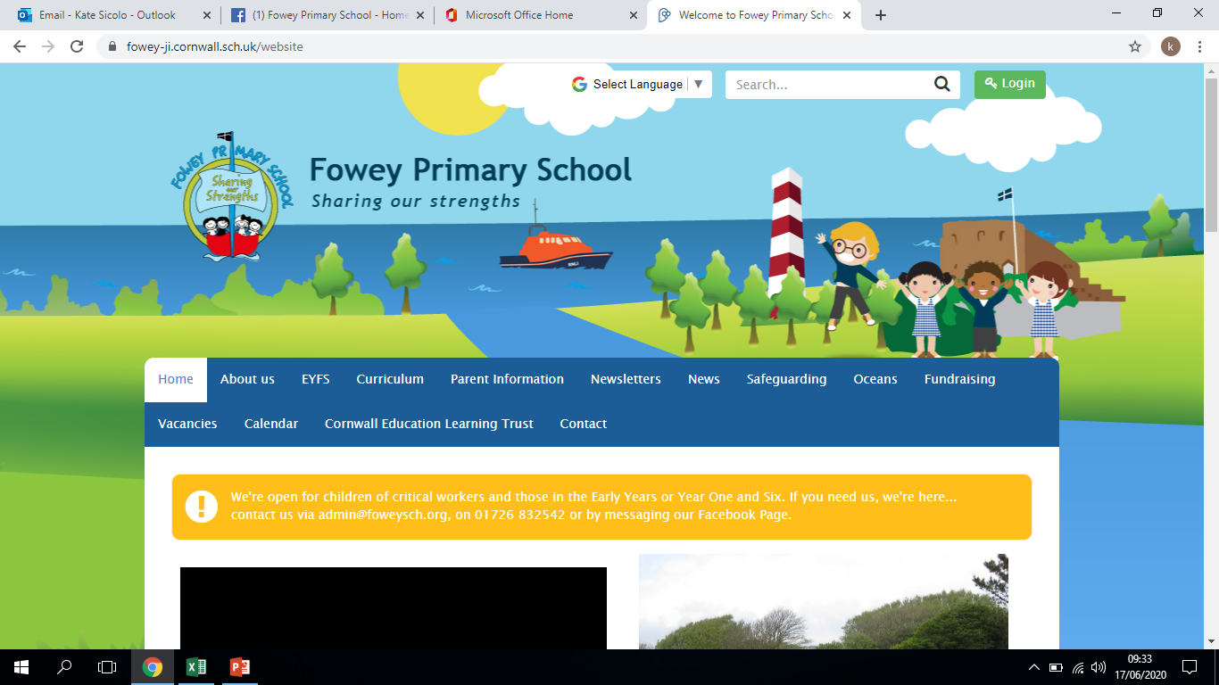

Slide 12
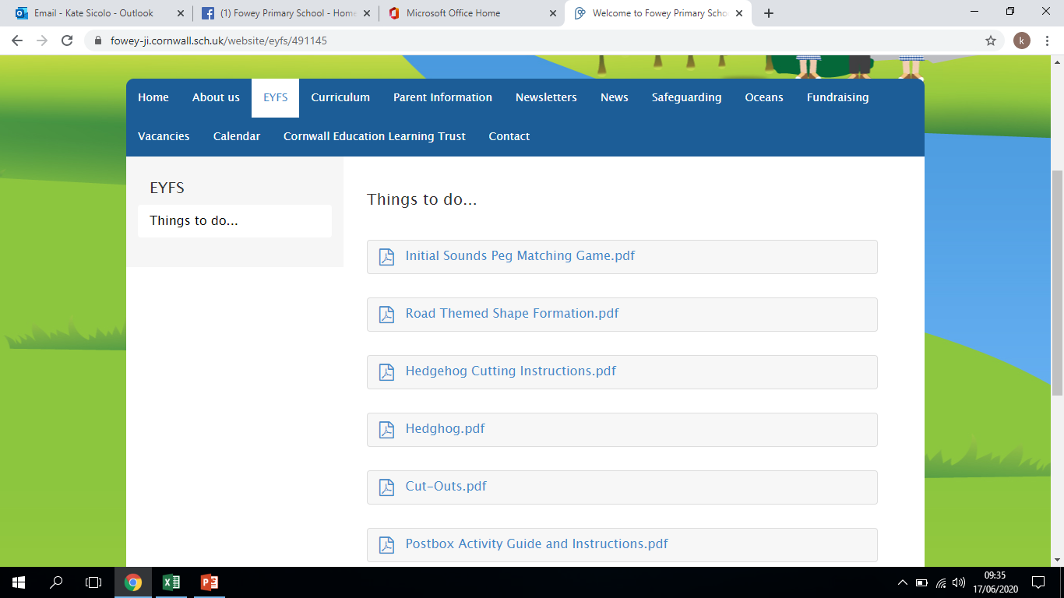

Slide 13
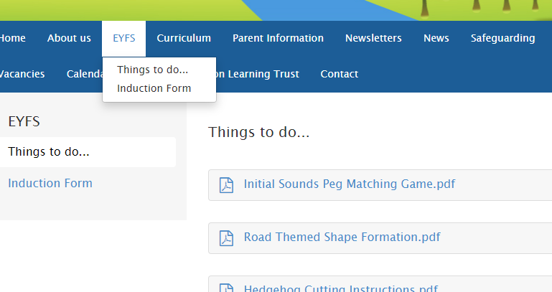
Please make sure you complete the induction form before you meet with Mrs Jones at the end of July…
You can find it here on the website in the EYFS area

Slide 14
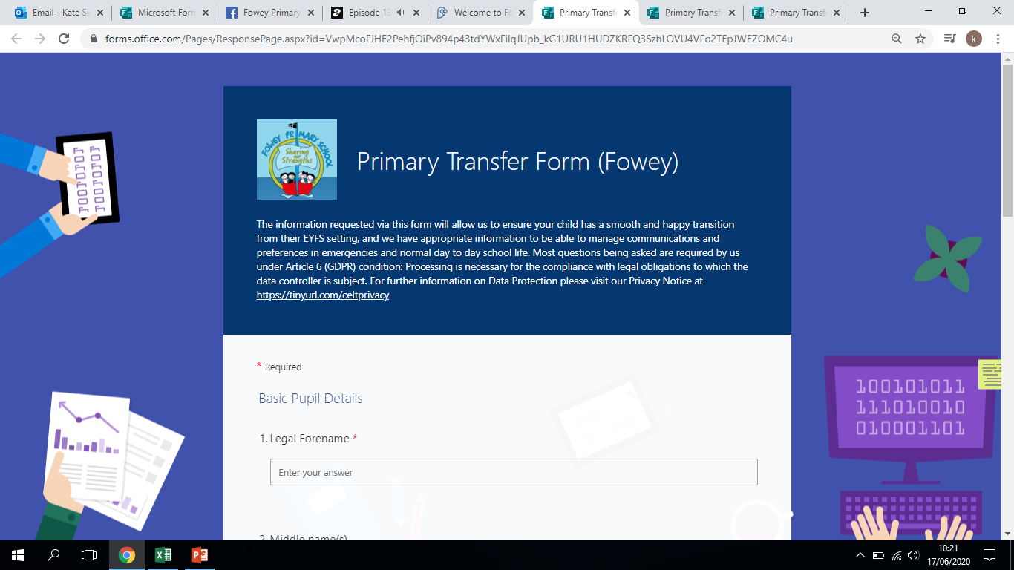

Slide 15
Thank you for signing up for a phonecall/zoom meeting to discuss your child in readiness for Sept.
If you haven’t made an appointment yet and would like one, they are on Thursday 15th and Friday 16th July.

Slide 16
Starting in Reception is a really exciting time, but can be an anxious time too for children and parents! I am always available before and after school if you would like a chat.
No issue is too small just let myself or any adult in the class know.
We look forward
to seeing you in
September!

